Slide 1
Applied Natural Language Processing
Dr. Sucharitha Shetty

Slide 2
Table of Contents
Recall
RNN –Recurrent Neural Network

Slide 3
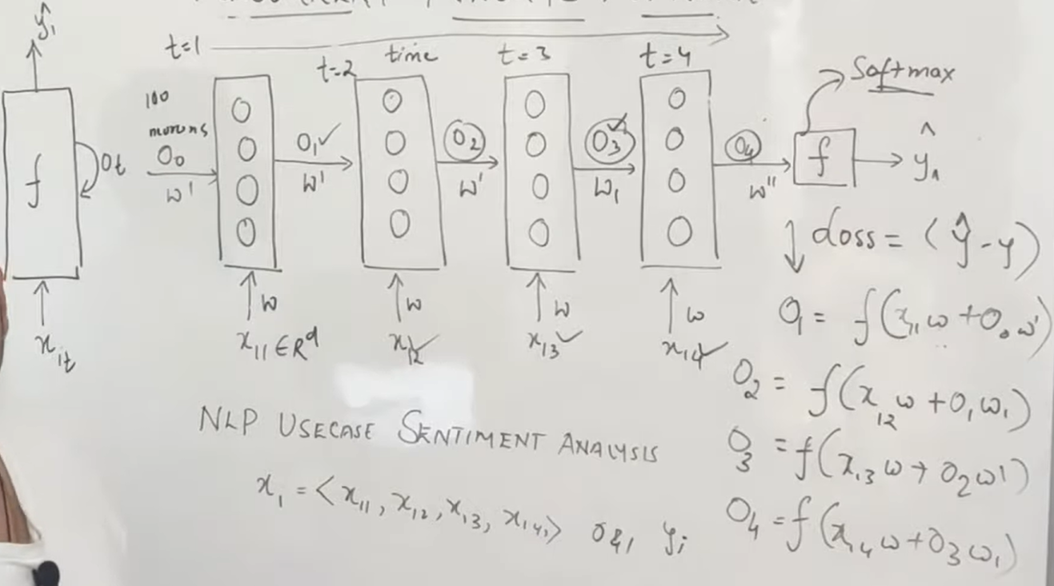
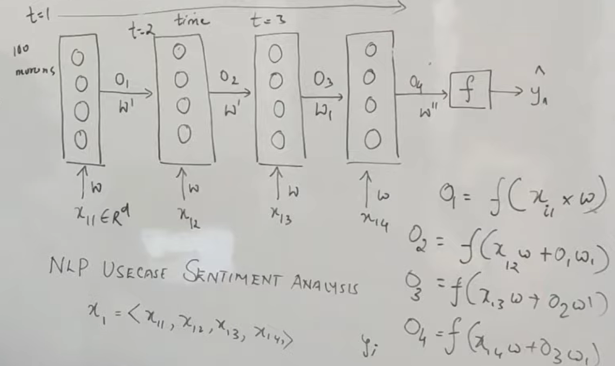
RNN
Sentiment Analysis :
Eg: The food is good – O/p is positive

Slide 4
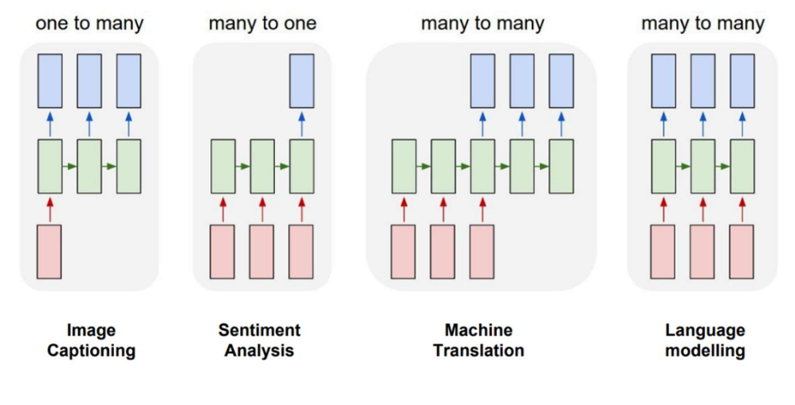
RNN Types

Slide 5
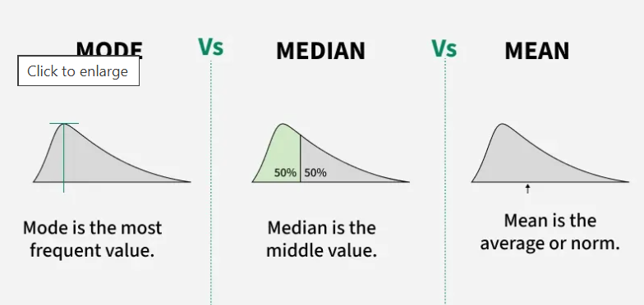
Mean, Median Mode

Slide 6
fit_transform vs transform
When to Use Each
fit_transform on Training Data: You use this for your training dataset to ensure the model learns the necessary transformation parameters (like the mean and standard deviation for scaling or vocabulary for text processing) only from the data it is allowed to see. It is generally more efficient than calling fit() and transform() separately on the same data.
transform on Test/Validation Data: You must use transform() on your test or validation data. This is crucial to prevent data leakage, where information from the test set (which is meant to be unseen data) influences the model's training or preprocessing steps. The test data is transformed using the exact same parameters that were calculated from the training data.

Slide 7
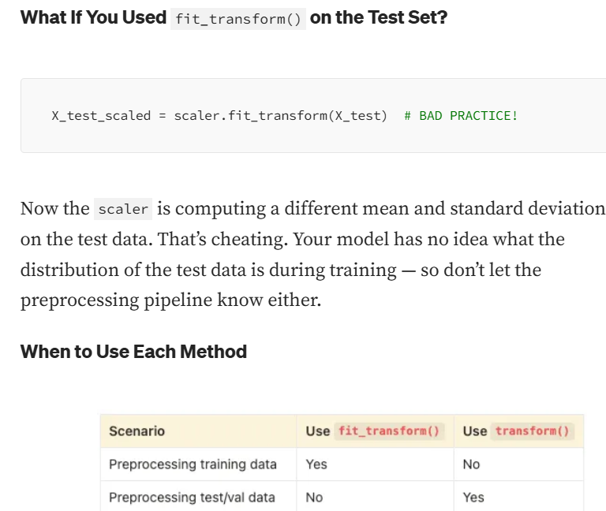

Slide 8
fit_transform vs transform
When to Use Each
fit_transform on Training Data: You use this for your training dataset to ensure the model learns the necessary transformation parameters (like the mean and standard deviation for scaling or vocabulary for text processing) only from the data it is allowed to see. It is generally more efficient than calling fit() and transform() separately on the same data.
transform on Test/Validation Data: You must use transform() on your test or validation data. This is crucial to prevent data leakage, where information from the test set (which is meant to be unseen data) influences the model's training or preprocessing steps. The test data is transformed using the exact same parameters that were calculated from the training data.

Slide 9
Normalization Vs standardization
Normalization scales data into a specific range (usually 0 to 1) using minimum and maximum values, making it ideal for algorithms not assuming distribution, like neural networks or K-Nearest Neighbors. Standardization centers data around a mean of 0 with a standard deviation of 1, handling outliers better and assuming a Gaussian distribution, which suits linear regression or logistic regression.
Notes:
https://medium.com/@abhishekjainindore24/normalization-and-standardization-of-data-408810a88307

Slide 10
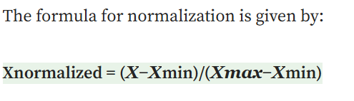

Key Differences Between Normalization and Standardization:
Normalization scales data into a specific range (usually 0 to 1) using minimum and maximum values, making it ideal for algorithms not assuming distribution, like neural networks or K-Nearest Neighbors. Standardization centers data around a mean of 0 with a standard deviation of 1, handling outliers better and assuming a Gaussian distribution, which suits linear regression or logistic regression.
Outliers:
Normalization: Highly sensitive to outliers because it relies on the minimum and maximum values.
Standardization: Less sensitive to outliers; it handles them better because it uses mean and standard deviation rather than absolute boundaries.
Notes:
https://medium.com/@abhishekjainindore24/normalization-and-standardization-of-data-408810a88307

Slide 11
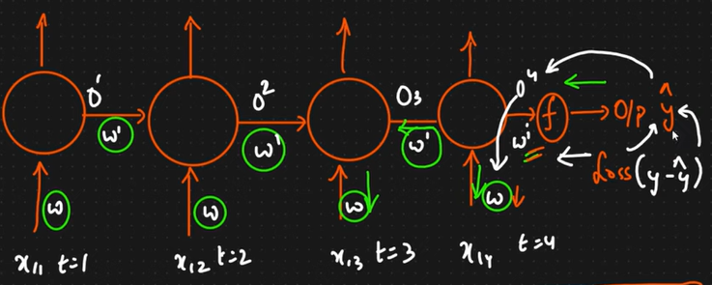
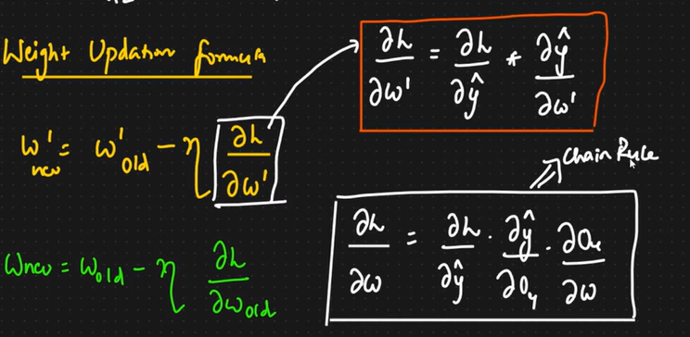
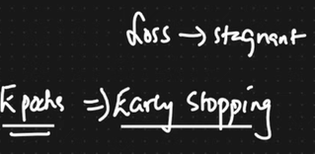
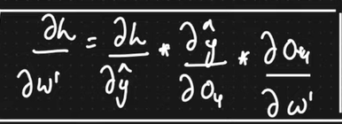
Backpropogation of RNN
Notes:
https://medium.com/@abhishekjainindore24/normalization-and-standardization-of-data-408810a88307

Slide 12
LSTM
Base blog to refer to..
https://colah.github.io/posts/2015-08-Understanding-LSTMs/
Notes:
https://medium.com/@abhishekjainindore24/normalization-and-standardization-of-data-408810a88307

Slide 13
Thank You

